Slide 1
Capstone Project on Sales(Prediction)
by Mohammed Saif

Slide 2

Content
Introduction
Data Exploration
Pre-processing
Feature Selection
Model Selection
Results
Conclusion
References
Notes:
1

Slide 3

Introduction
Problem Statement:
Develop a Regression model to accurately Predict the Sales based on available data.
Key Features of the Problem:
Accurate Price Prediction.
Understanding Influential Factors.
Reliable Estimation for Future Purchases.
Price Optimization.
Enhanced Decision Making.
About the dataset: The dataset consists of sales transaction records from a supercentre, capturing customer information, product details, pricing, and customer satisfaction ratings The dataset provided comprises three months of data from three stores in three cities.
Notes:
2

Slide 4
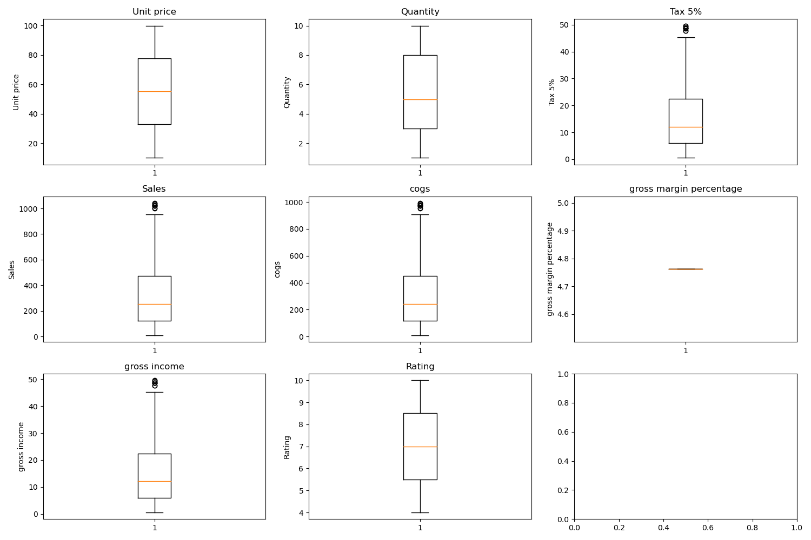

Data Exploration
Describe the data in detail:
The dataset provided comprises three months of data from three stores in three cities. It contains 1000 rows and 17 columns, including 6 categorical columns, 8 numerical columns, and 3 columns for Invoice ID, Date, and Time. Notably, the dataset is complete without any missing values, but it does contain 11 outliers.
Outliers
Notes:
3

Slide 5
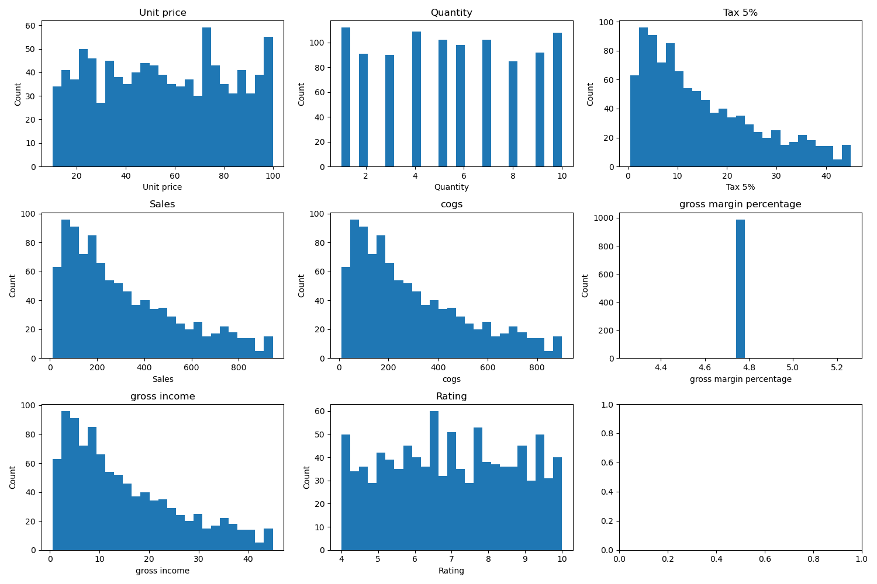
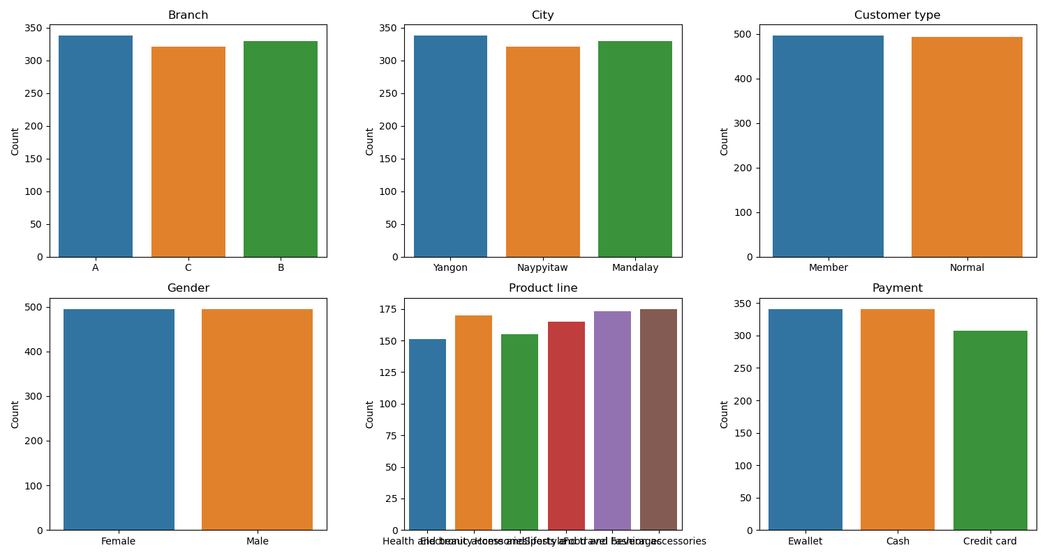
Data Exploration
Count Plot of Numerical and Categorical Features

Slide 6
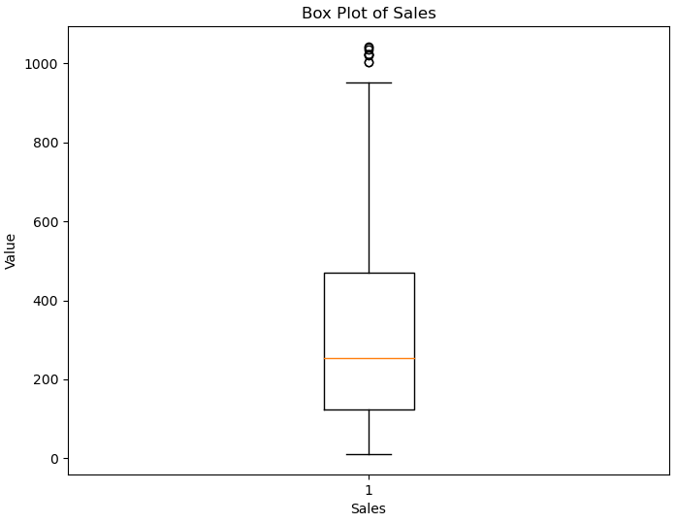
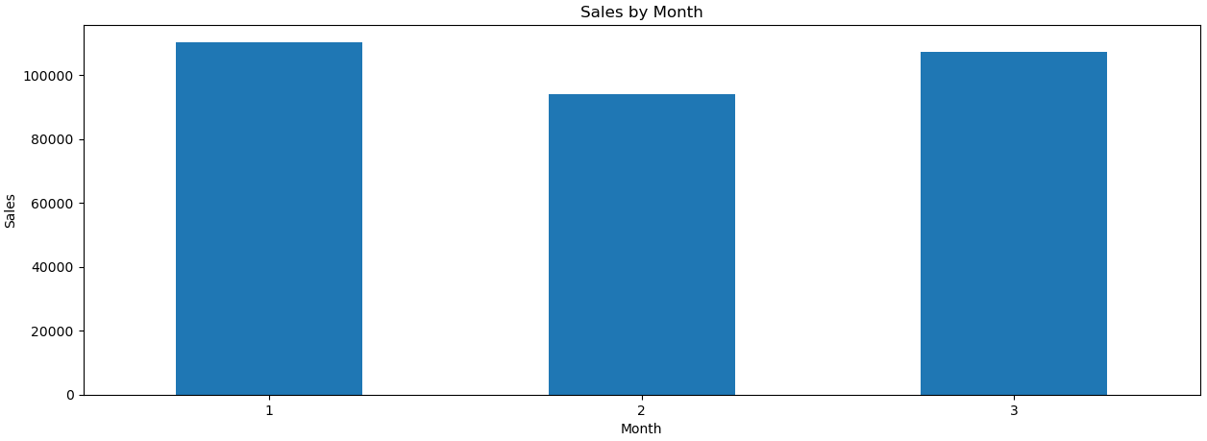
Pre-Processing
Handling Outliers:
There are only 11 outliers, and they are excluding from the dataset rather than replacing it.
Transformation:
Due to the presence of 89 unique values in the ‘Date’ column, I have transformed it into three distinct categories representing the months. Additionally, I have performed a type cast to convert it into a categorical feature.

Slide 7
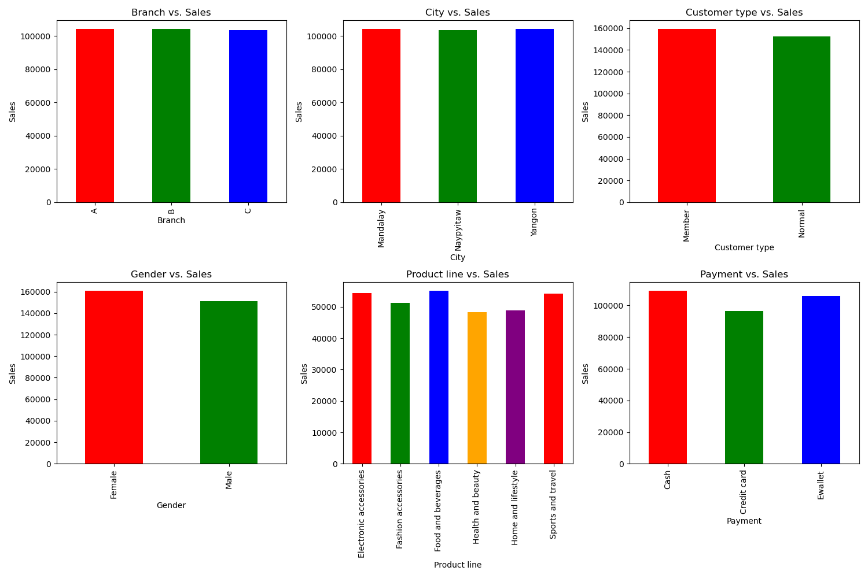
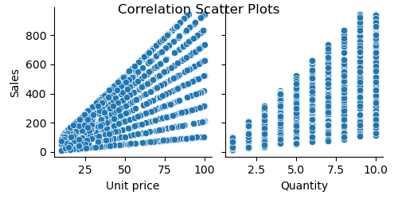
Feature Selection
Columns Dropped:
Invoice ID.
City.
Gross margin percentage.
Time and Rating.
Tax 5%, COGS (Cost of Goods Sold), Gross Margin Percentage, and Gross Income.
Dimensionality Reduction:
In order to reduce dimensionality, I have combined the six distinct categorical values in the 'Product line' column into three pairs:
Health and Beauty / Electronic Accessories.
Home and Lifestyle / Sports and Travel.
Food and Beverages / Fashion Accessories.

Slide 8

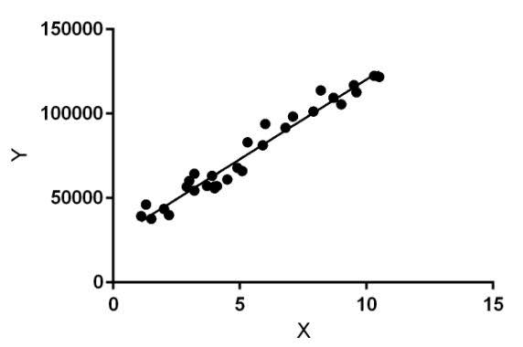
Model Selection
Algorithms used:
Linear Regression.
Decision Tree Regressor.
Random Forest Regressor.
Gradient Boosting Regressor.
Out of the 12 independent features, 2 of them are numerical and have undergone standardization using MinMaxScaler. On the other hand, 6 of the features are categorical and have been transformed into dummy variables using one-hot encoding. The Sales feature is considered as our Label. Additionally, the data has been divided into train and test sets with a split ratio of 80:20.

Slide 9

Results
Scores:
Algorithm Score Adjusted-r-Squared RMSE
Linear Regression 0.8515 0.8420 86.6322
Decision Tree Regressor 0.9985 0.9979 9.9298
Random Forest Regressor 0.9987 0.9986 8.0617
Gradient Boosting Regressor 0.9978 0.9976 10.5309
Compared Results:
In terms of performance, the Random Forest Regressor outperformed the other model with a higher score, higher adjusted R-squared, and lower RMSE. The Random Forest Regressor takes advantage of an ensemble of decision trees, which often leads to better predictive accuracy compared to a single linear regression model. Therefore, based on the given results, the Random Forest Regressor is considered the best model among the options provided.

Slide 10

Results
Limitations of Models:
Linear Regression:
Assumption of linearity,
Sensitivity to outliers,
Limited flexibility.
Decision Tree Regressor:
Overfitting,
Lack of smoothness.
Limitations of Models:
Random Forest Regressor:
Computational complexity,
Interpretability.
Gradient Boosting Regressor:
Potential overfitting,
Sensitivity to noise/outliers.

Slide 11


Conclusion
Summary:
The project aimed to develop a Regression model to Predict the Sales of a product using available data. The objective was to gain insights into the factors that influence the total price and create a reliable estimation for future purchases.
Conclusion:
The Random Forest Regressor model was successfully implemented and evaluated using appropriate metrics. The model demonstrated promising performance, achieving a relatively high score and adjusted R-squared value, indicating a reasonable fit to the data. It provided valuable insights into the factors that impact the Sales price, helping to understand the pricing dynamics of the product.
Suggestions (for Future work):
Gathering more Data.
Time-Series Analysis.

Slide 12

Reference
Resources:
Kaggle: https://www.kaggle.com/ (A platform for data science competitions and datasets).
Scikit-learn documentation: https://scikit-learn.org/stable/documentation.html (Documentation for the Scikit-learn library).
one of the offline resources utilized in this capstone project is the Boston Institute of Analytics. The institute served as a valuable source of guidance, materials, and knowledge throughout the course, contributing to the development and execution of this project.

Slide 13
THANK YOU

